Slide 1
Fall Update 2
Dev Bhatia
Ultrafast Optics Laboratory
Boston University

Slide 2
Summary of Summer Work

Slide 3
General Timeline
Temperature Fitting
Gain fitted equations from the temperature transient
Implement equations in established NEURON file
Implement equations in python
Modify certain parameters to understand effects
Gain a deeper understanding of the Hodgkin - Huxley model
Understand the effects of temperature on ion channel kinetics
Temperature Simulation Script
NEURON Library

Slide 4
Lingering Questions

Slide 5
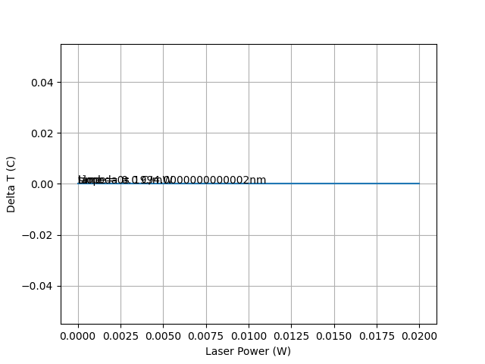
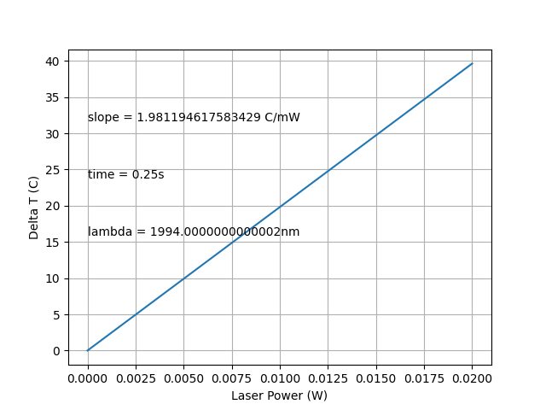
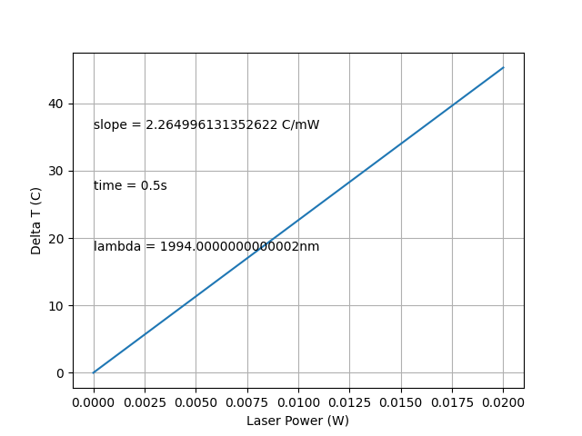
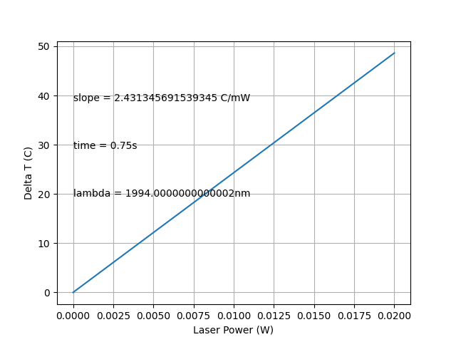
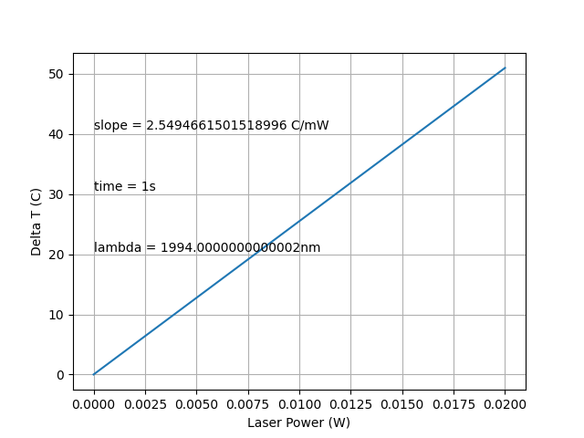
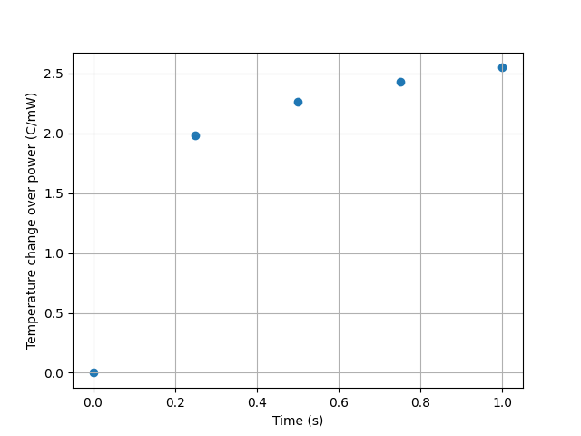
Varying Laser Power
A
B
C
These ΔT vs. Laser power graphs seem far higher than they should be
D
E
F
**The x-axis represents the initial power**

Slide 6
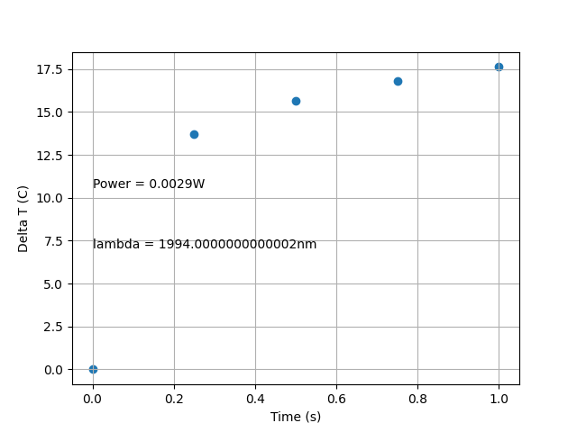
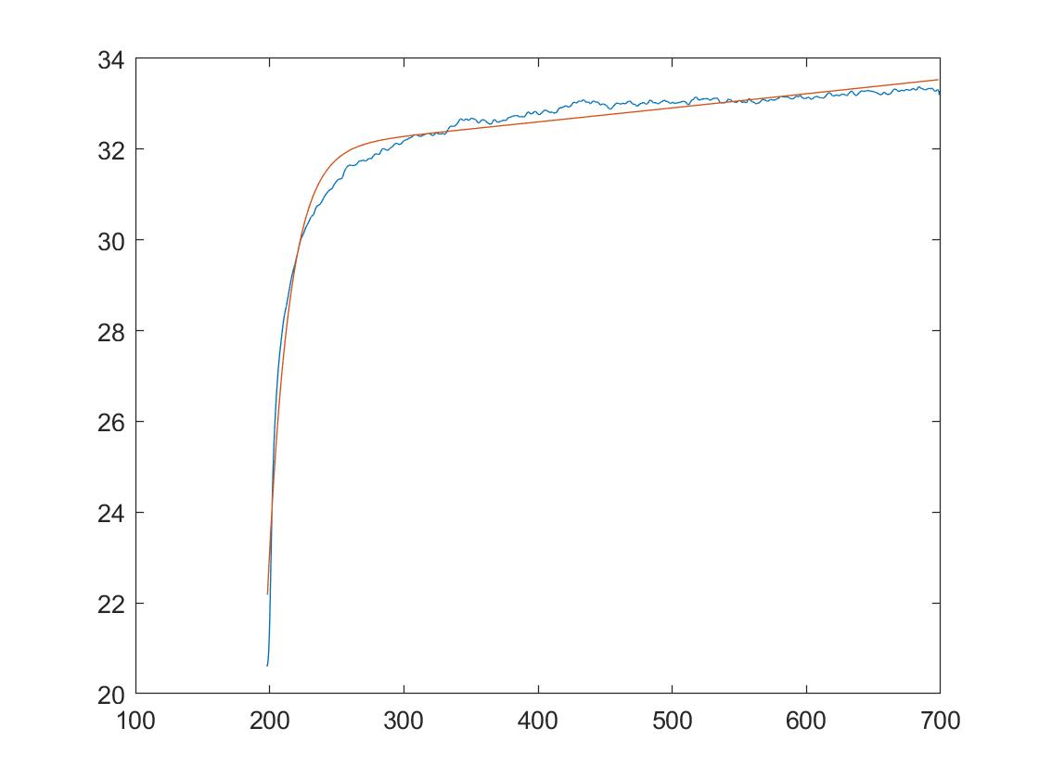
Script Comparison to Experimental Temperature Data
The delta T is somewhat consistent with the experimental data, but can be improved

Slide 7
Next Steps

Slide 8
Next Steps
Dive back into scripts from the summer, figure out why the temperature deltas are so high
Find a way to integrate the last INS paper into the existing model
A new script may be created to see if it better fits experimental data

